Slide 1
The C3X Experience
Ahmed Imran

Slide 2
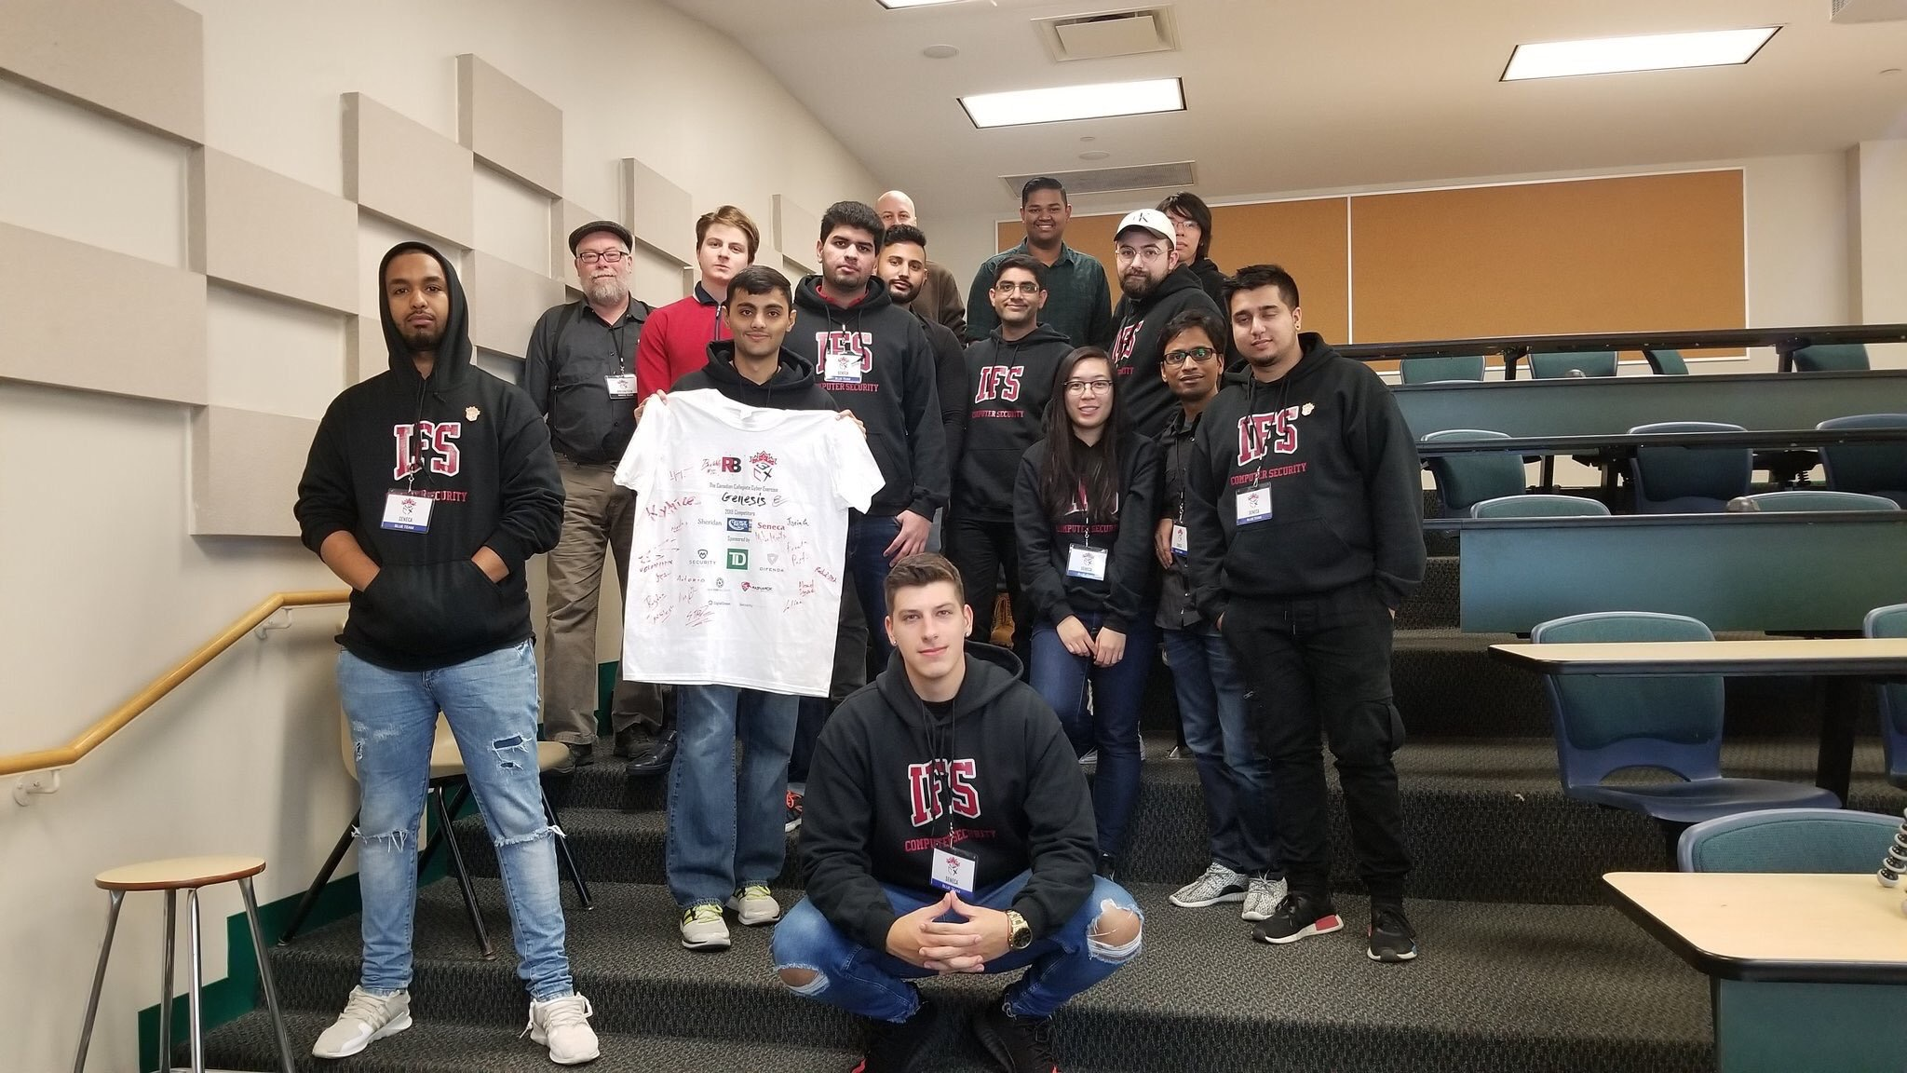
C3X 2018 Genesis – Blue Team

Slide 3
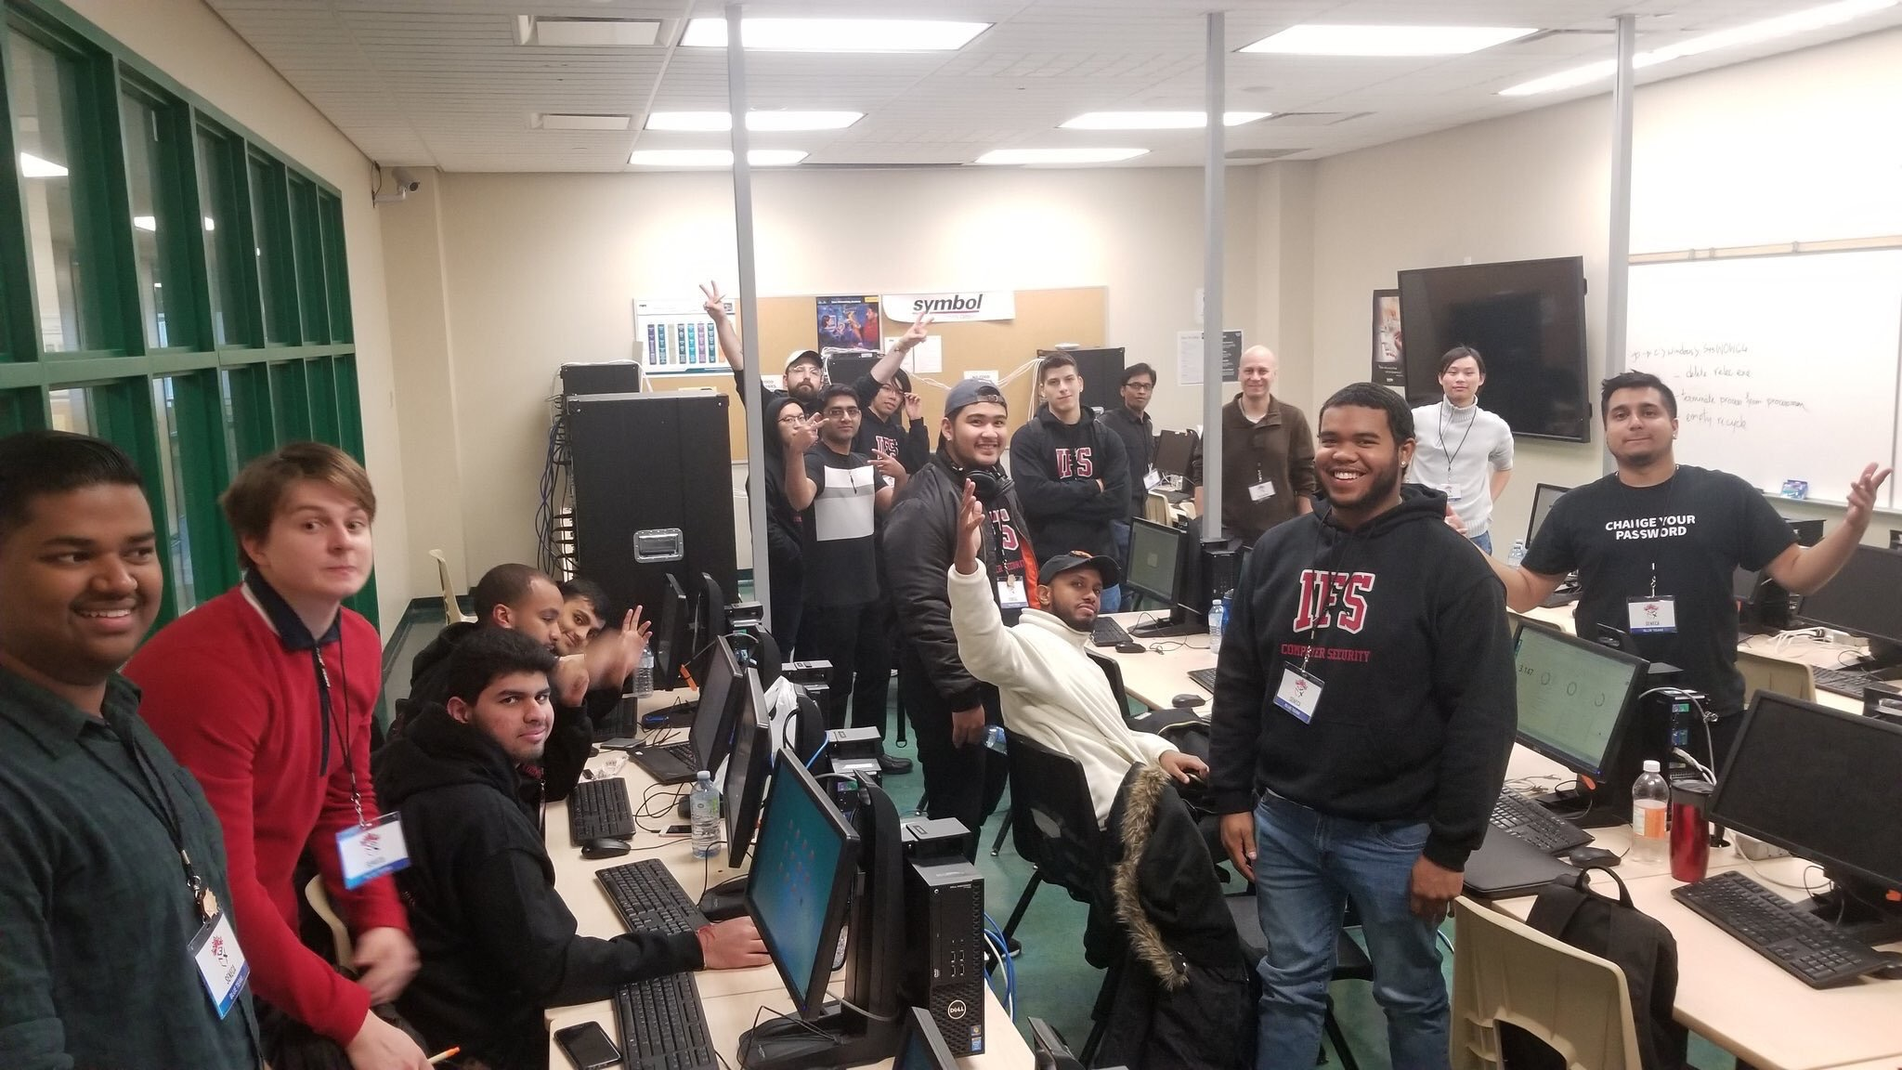
C3X 2018 Genesis – Blue Team

Slide 4
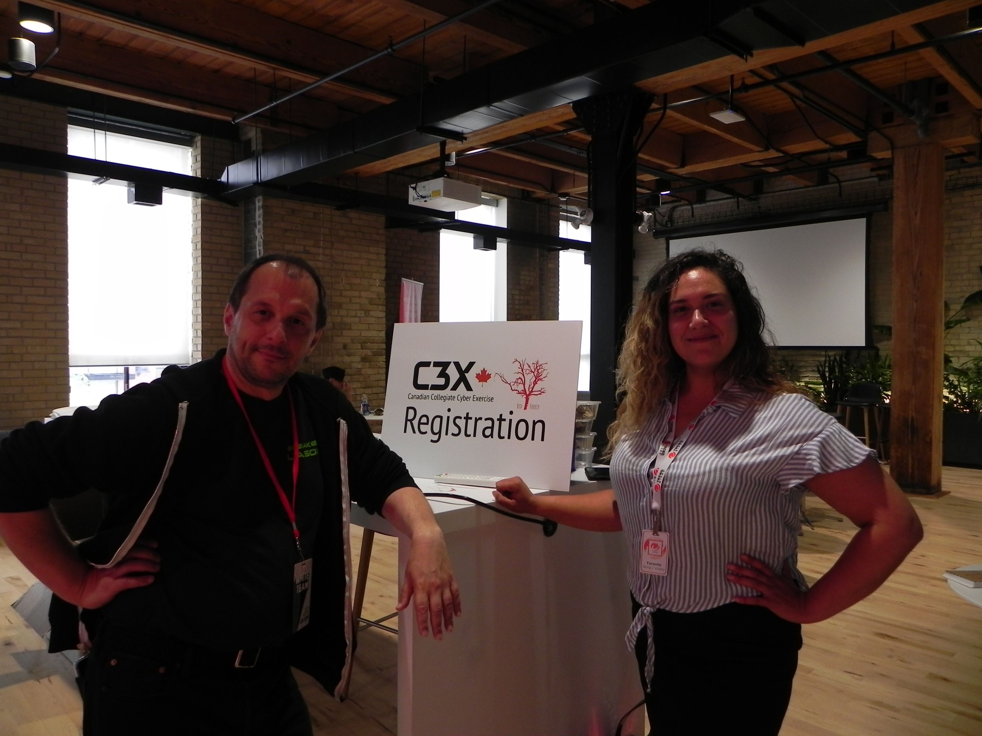
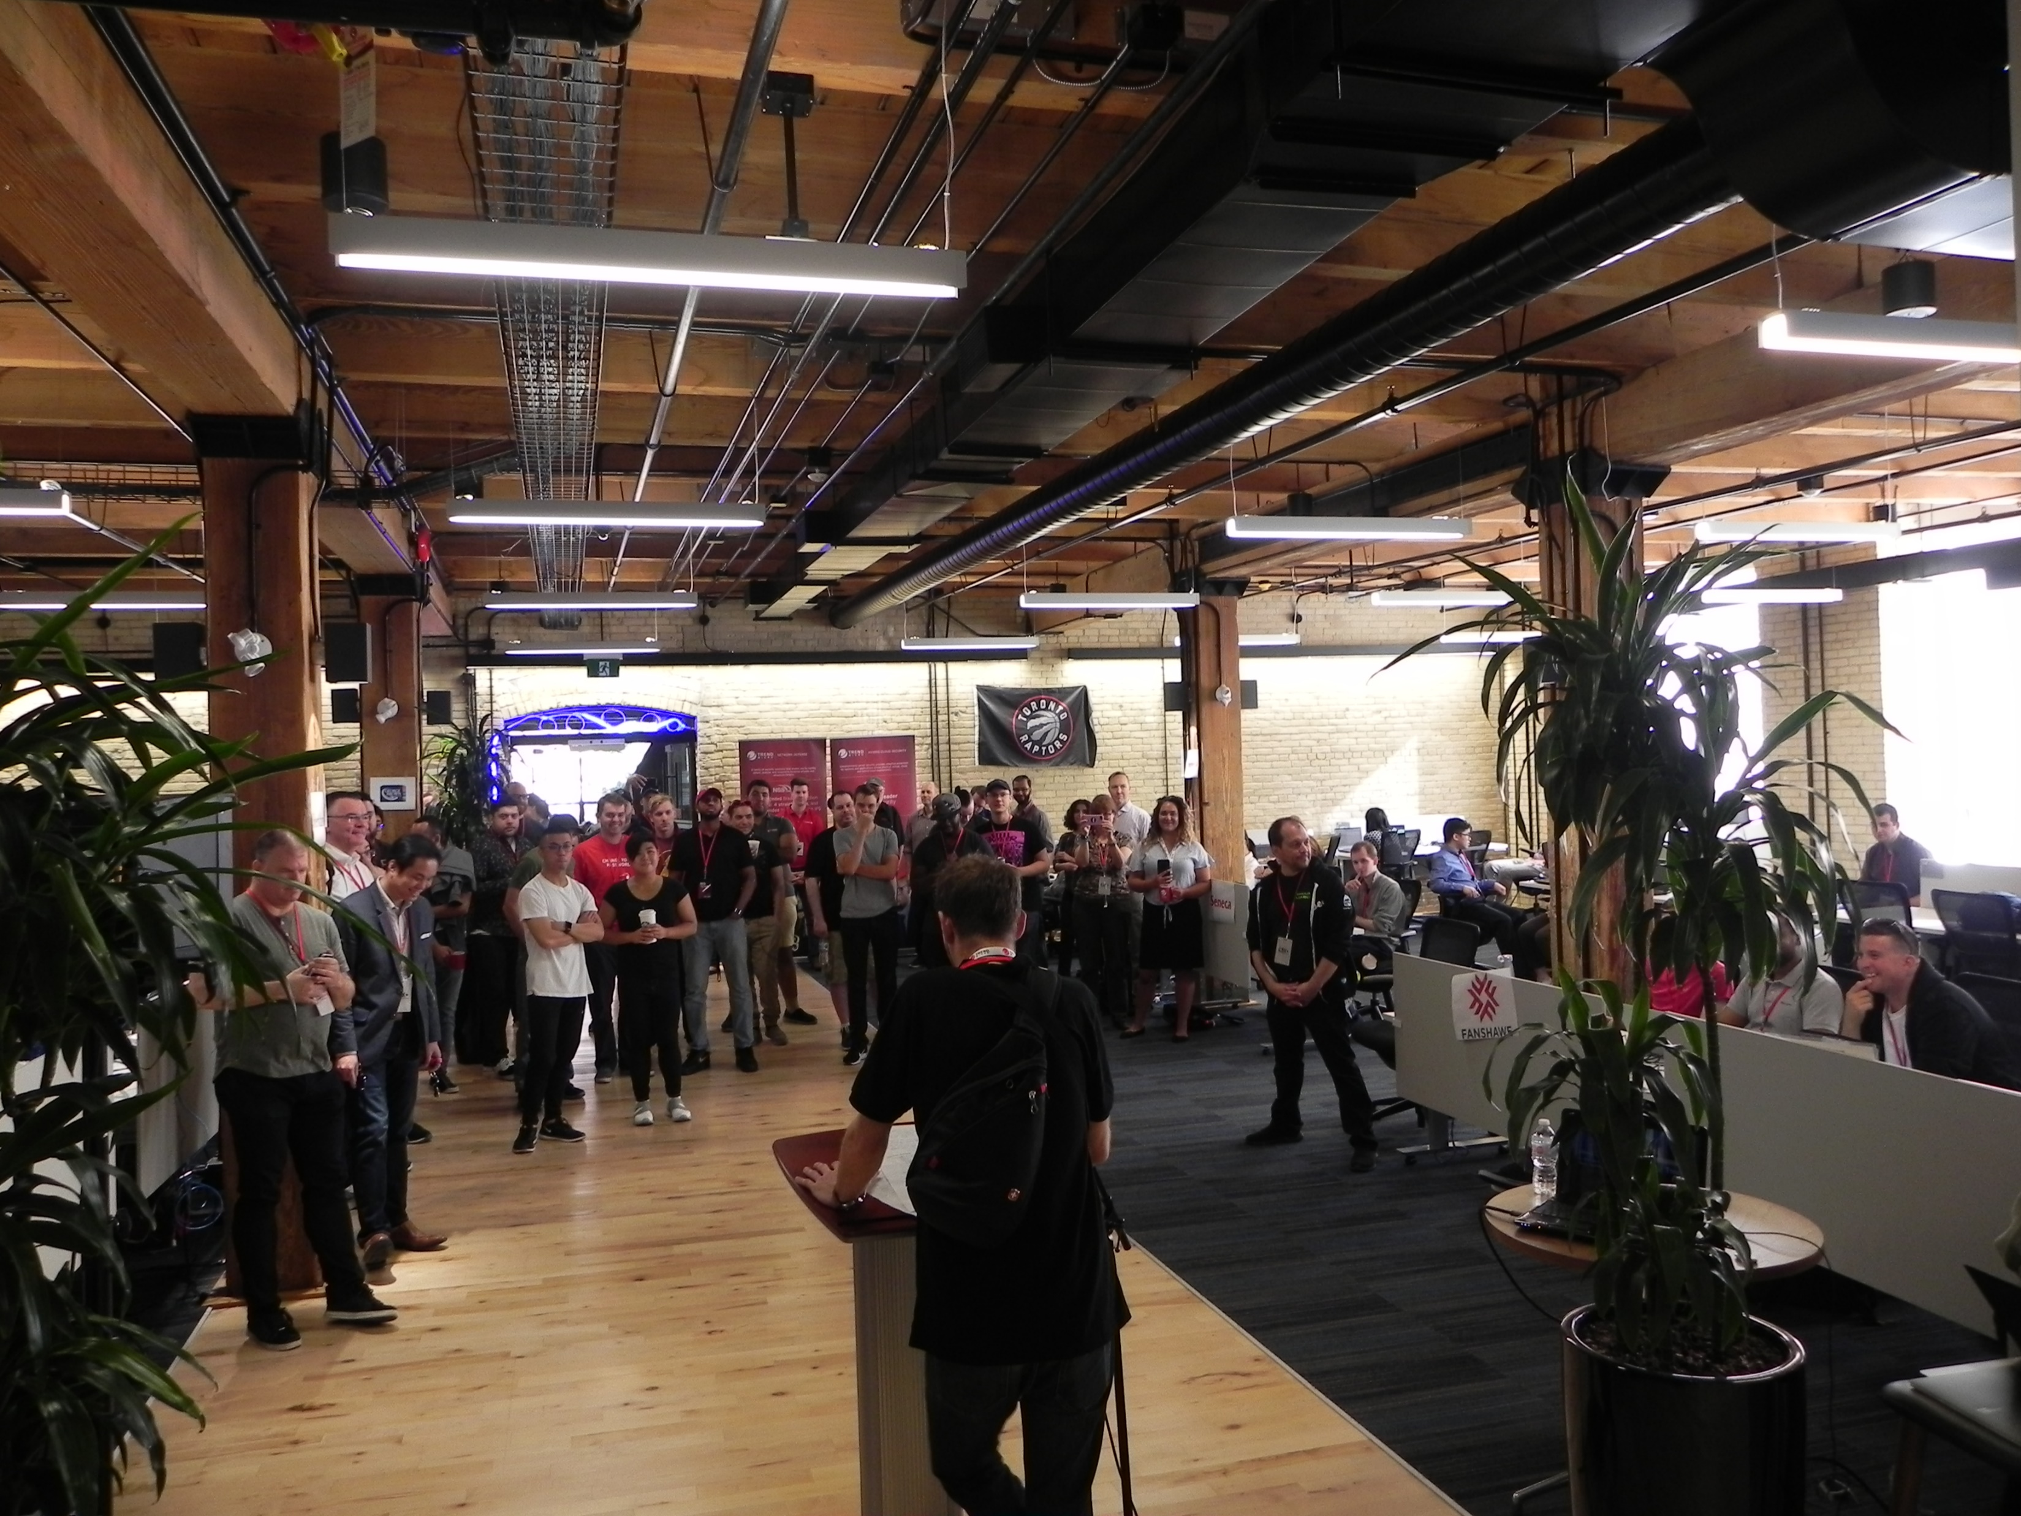
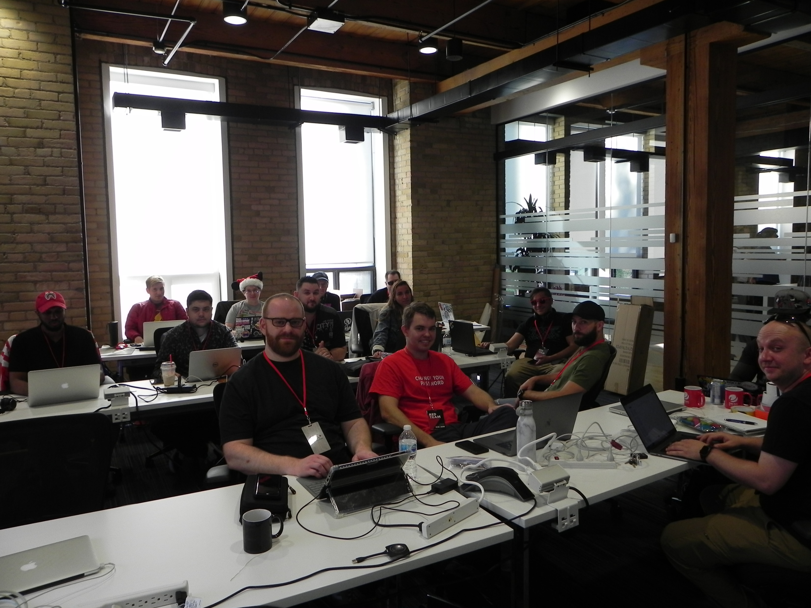
C3X 2019 Red Forest – White Team
Notes:
Allan and Laylee (top)
Red Team starting the day (bottom right)
Event start conference/talks (bottom right)

Slide 5
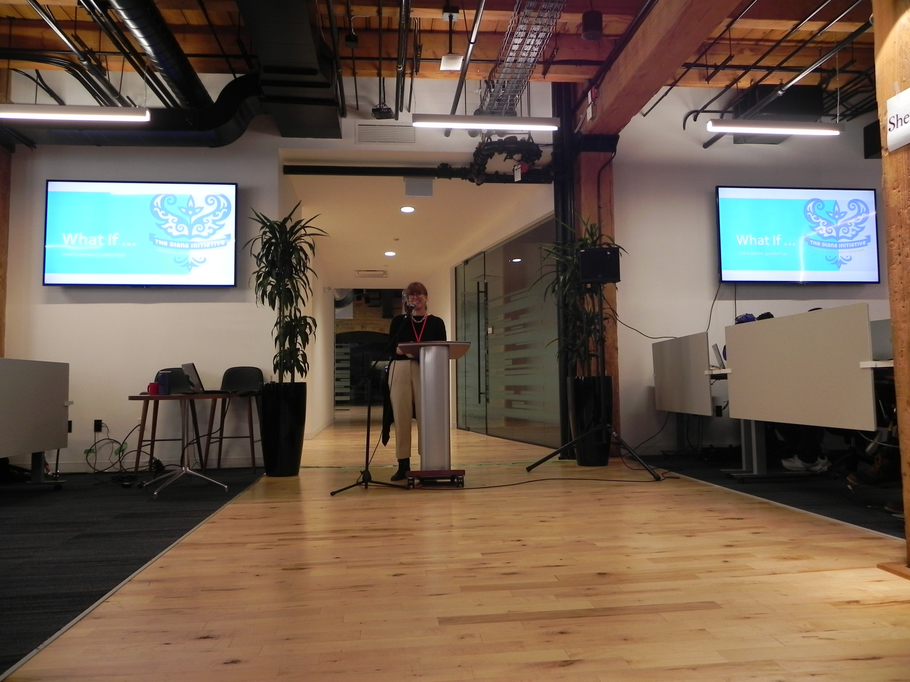
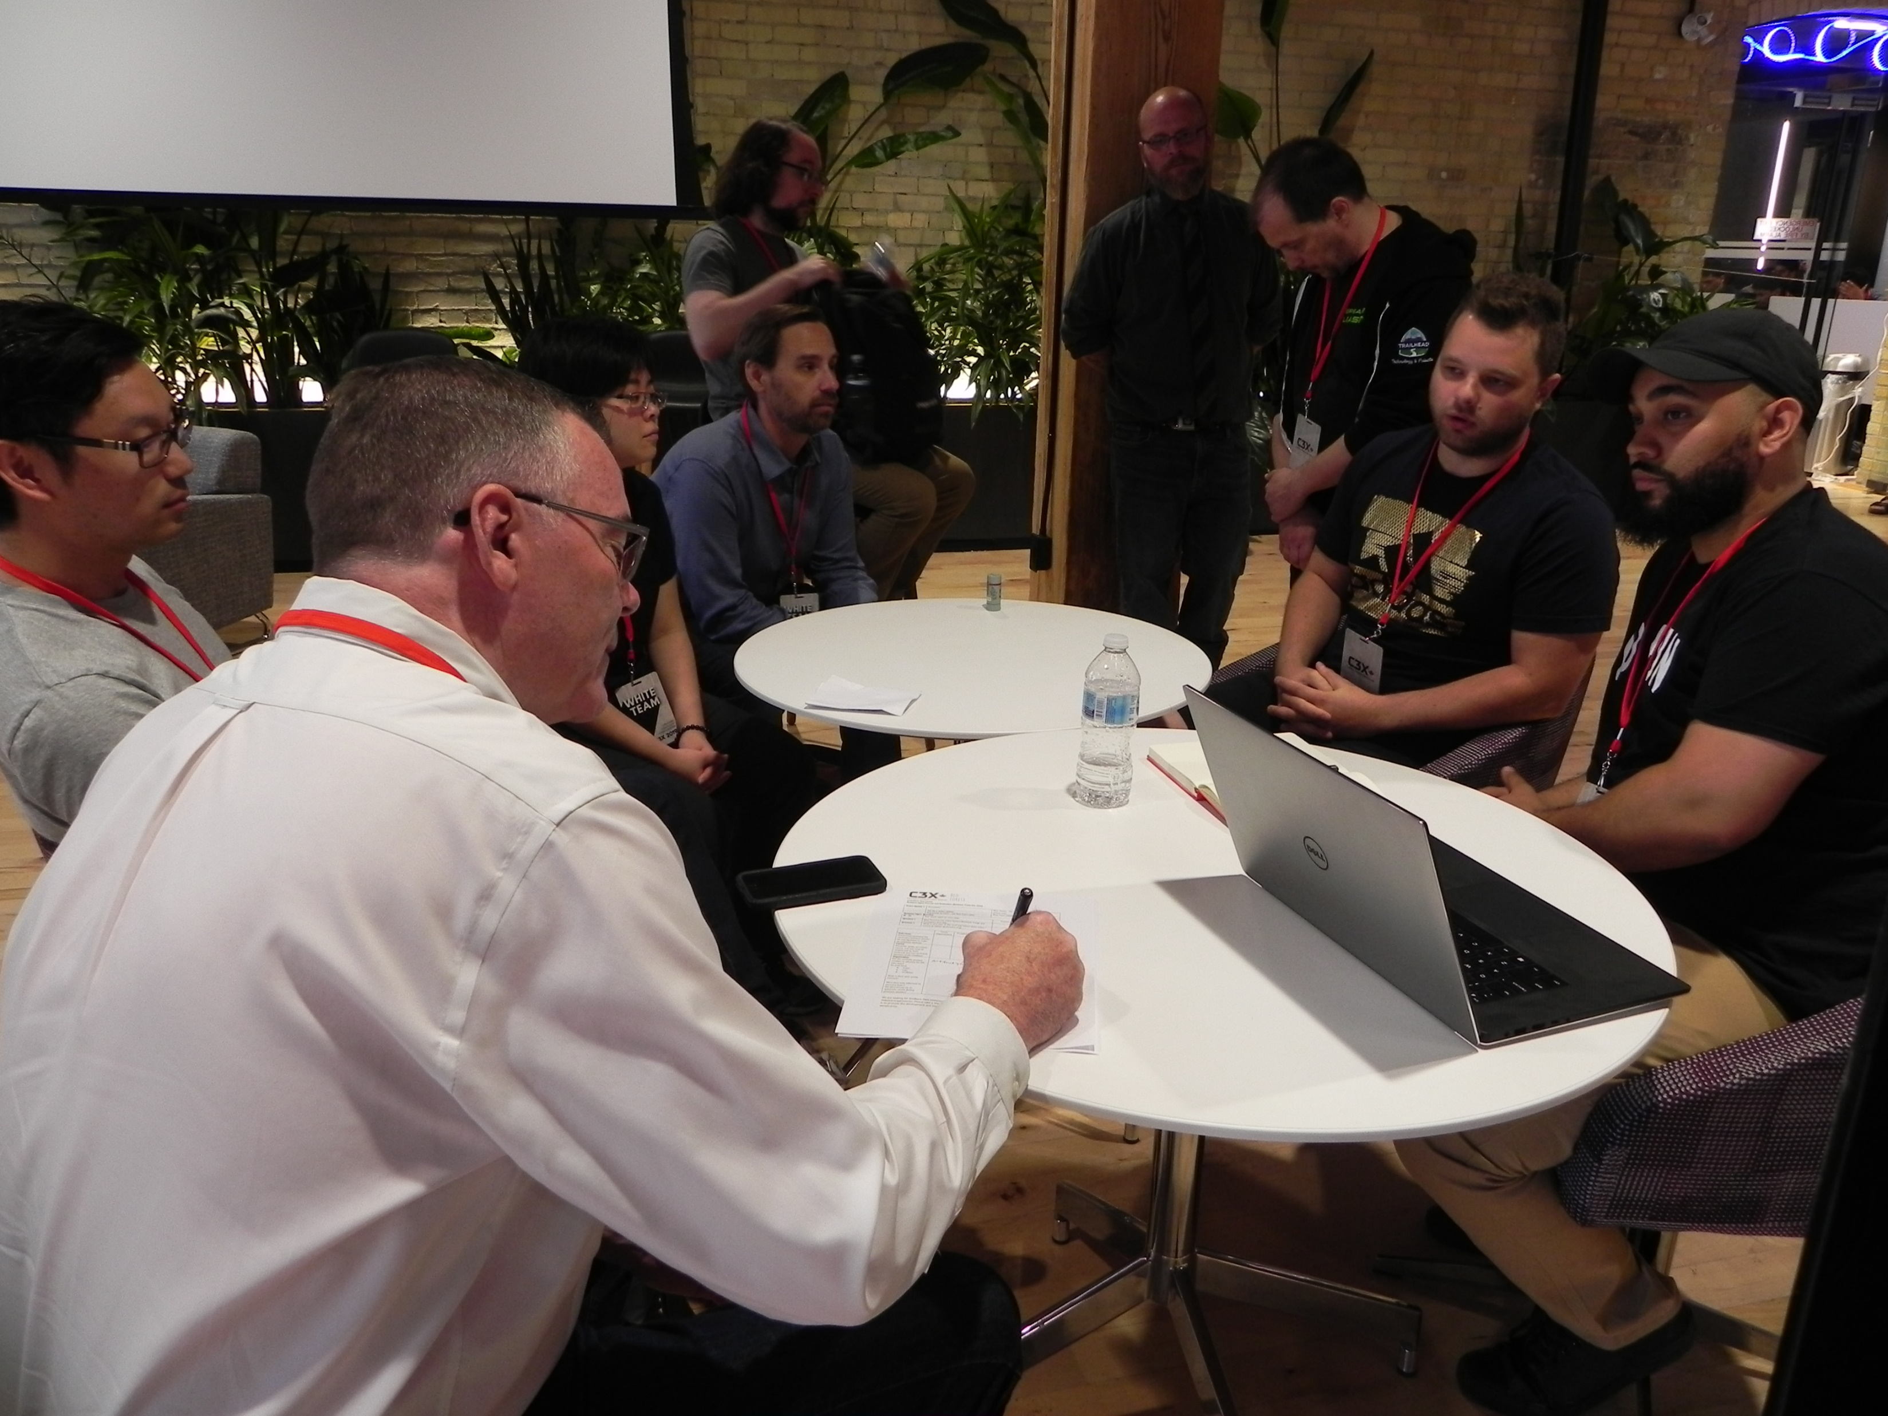
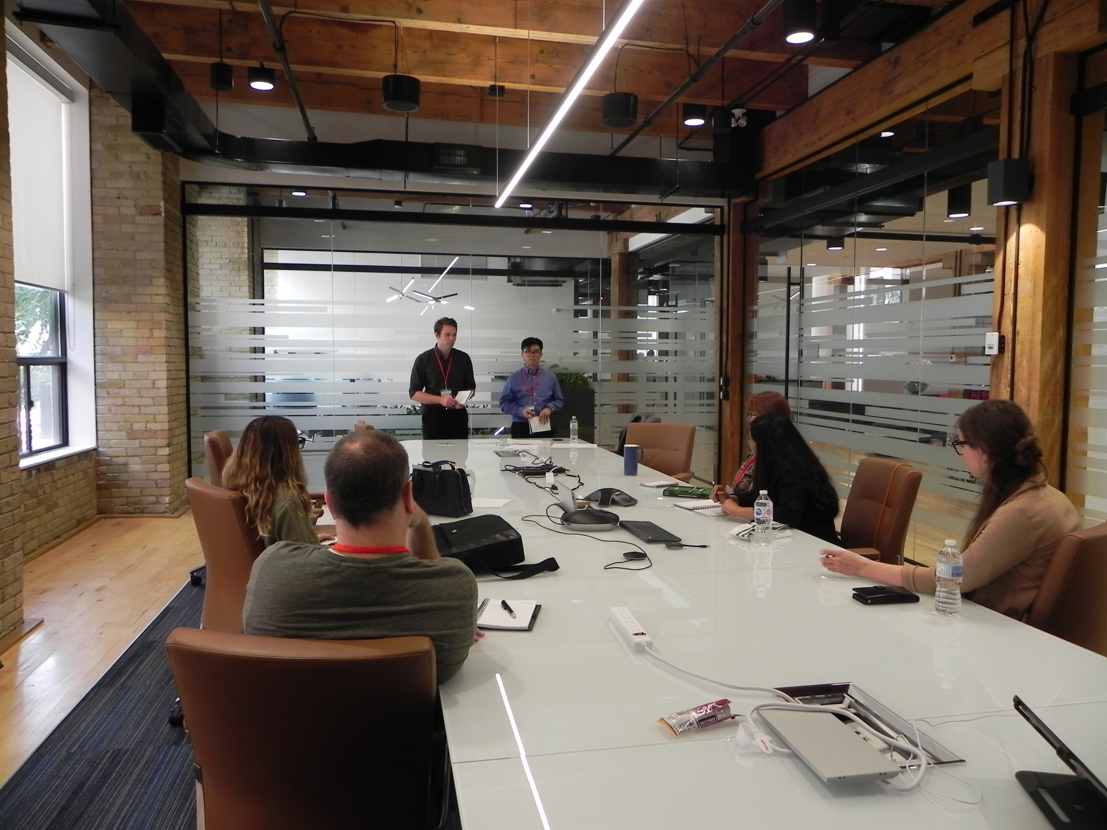
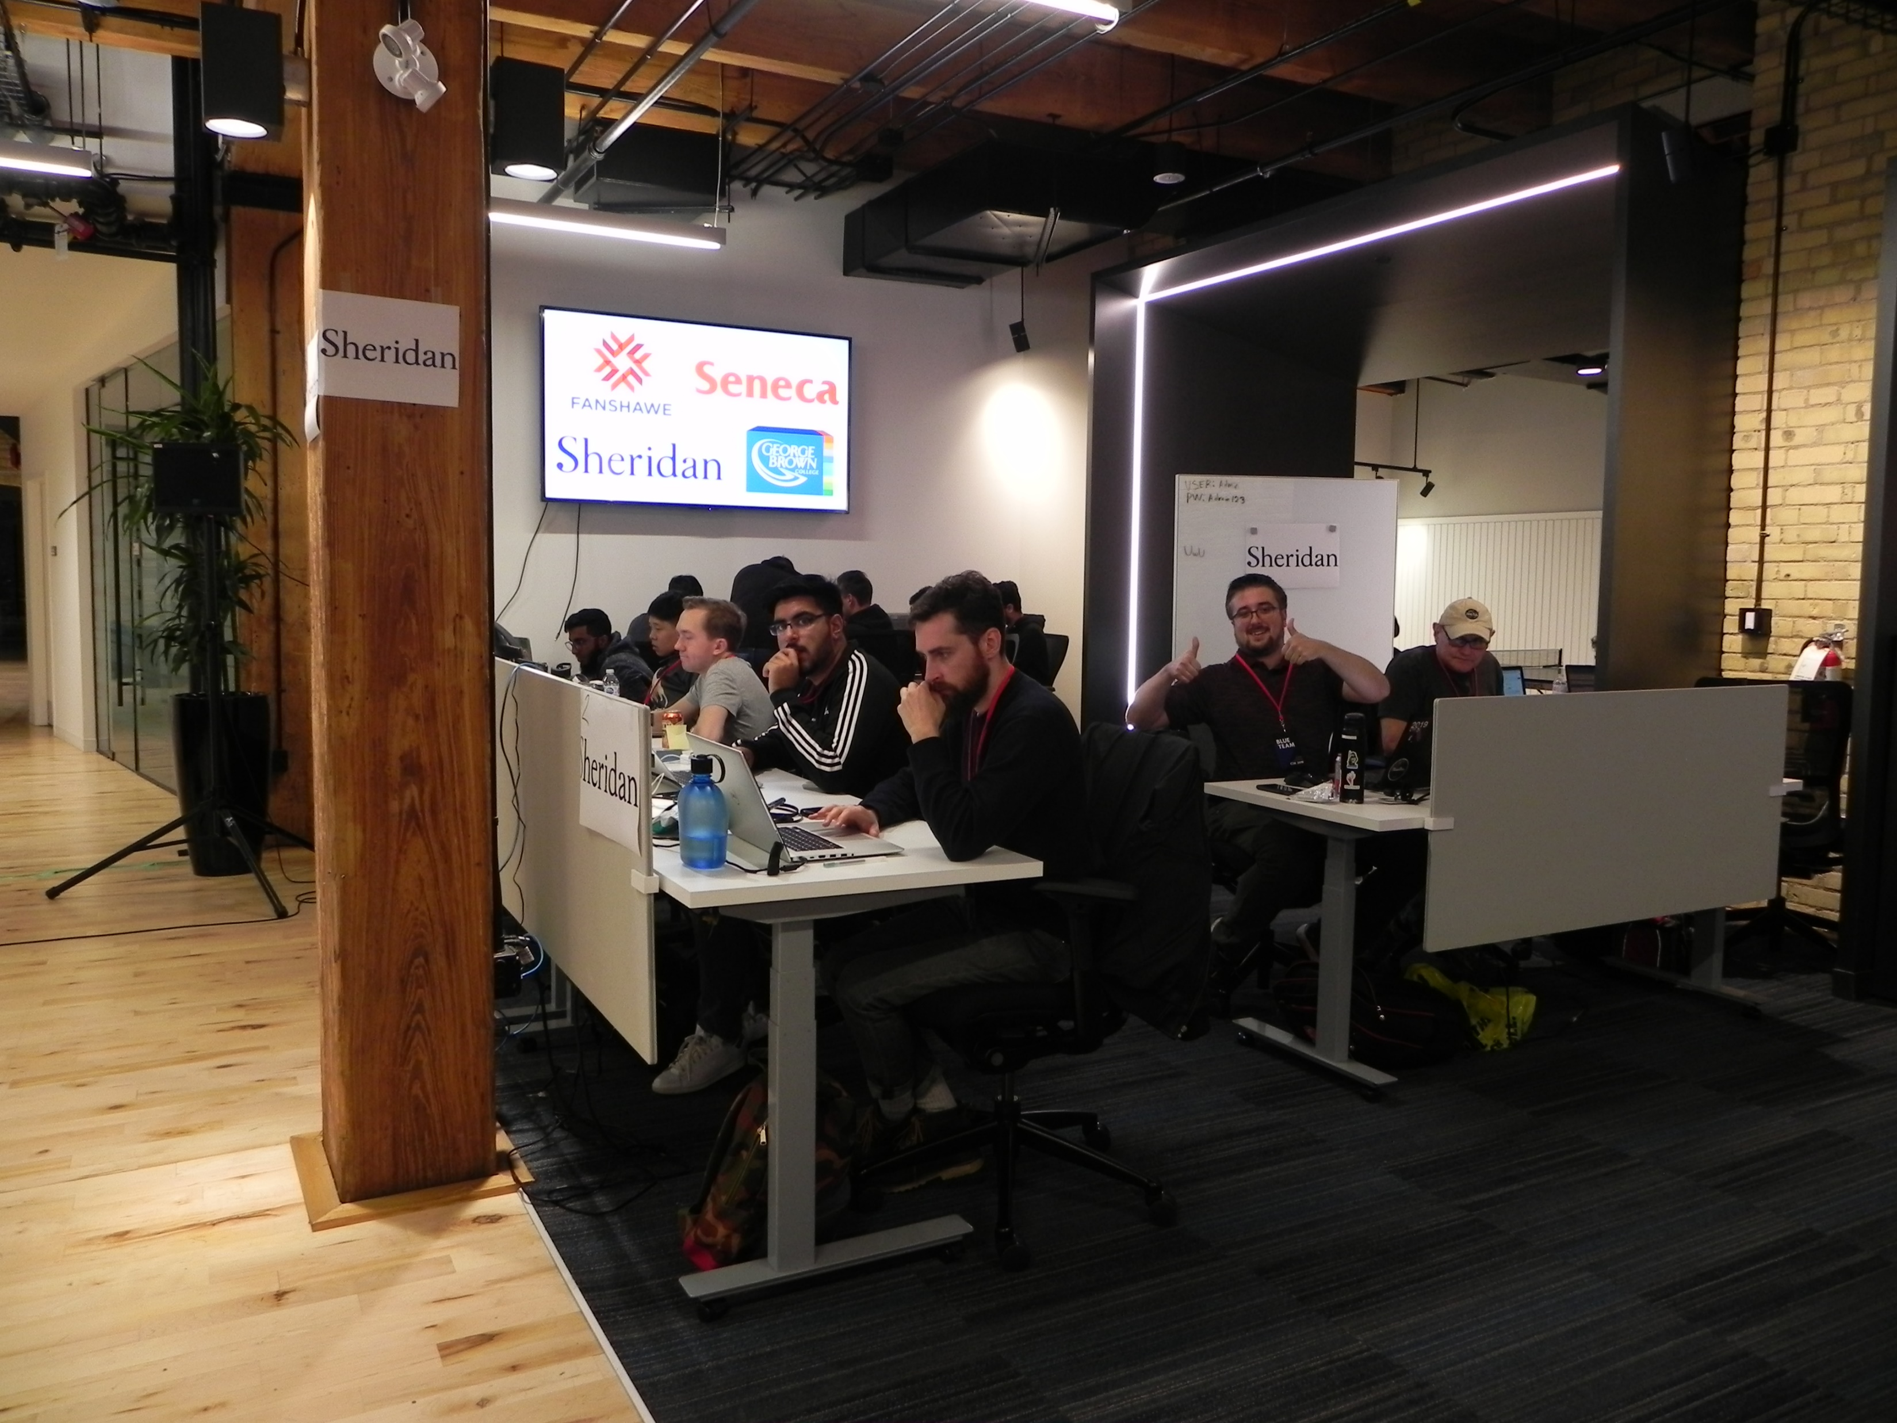
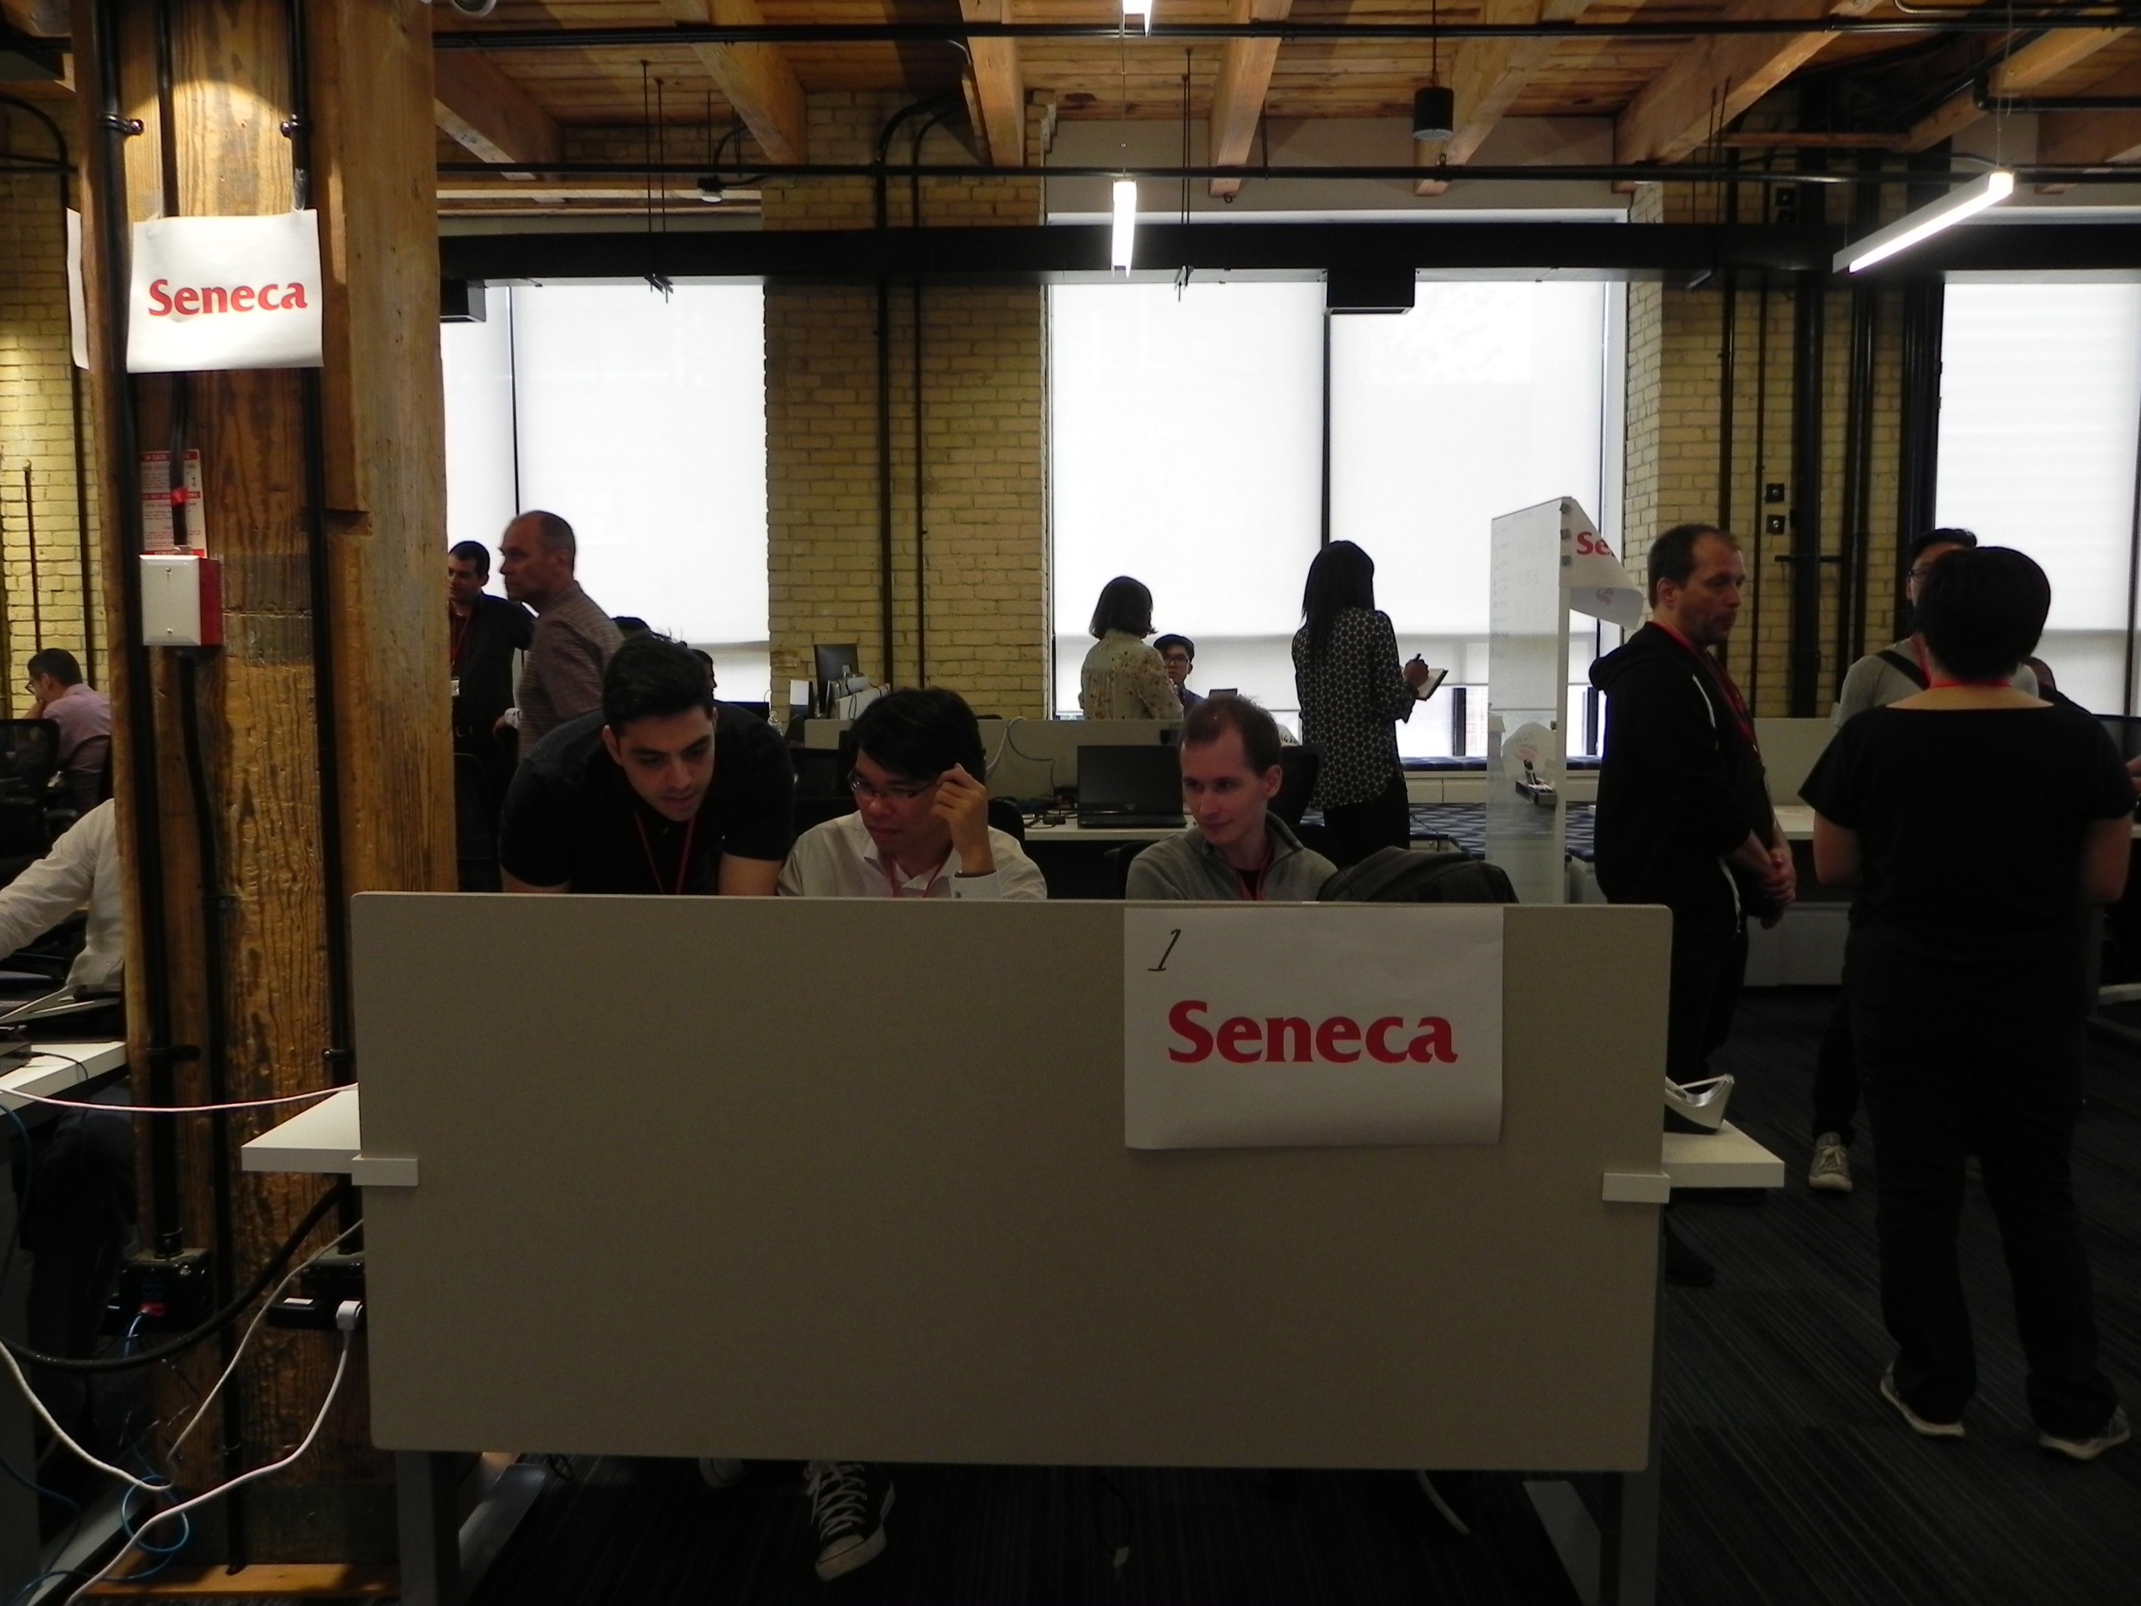
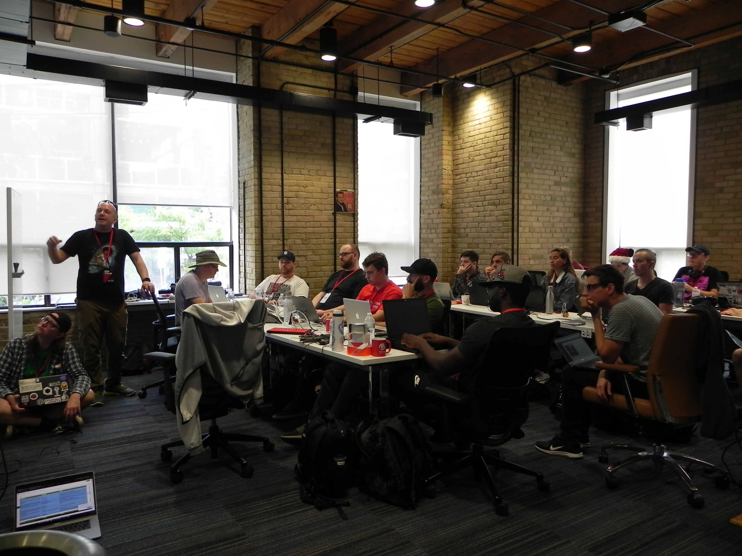
Notes:
Top Left – Cheryl Biswas Diana Initiative Key Note
Top Centre – Business Injects Fanshawe
Top Right – Business Inject Seneca
Bottom Left – Seneca
Bottom Centre – Sheridan
Bottom Right – Red team discussing tactics

Slide 6
The Game
CTF vs C3X

Slide 7
Capture the Flag
Competition Based
Teams compete to obtain flags
Test & apply skills
Red vs Blue team
Red team are competitors
Blue team typically automated

Slide 8
What is C3X?
Canadian Collegiate Cyber Exercise
Game/Educational
Learn and test skills
Special* Red vs Blue team exercise

Slide 9
What is C3X?
Blue Team
Students
Red Team
Industry Professionals
White Team
Mentors
Industry Professionals
Volunteers

Slide 10
Game Format
C3X Genesis vs C3X Red Forest

Slide 11
C3X 2018 Genesis Format
Hosted at George Brown College
Each team on separate day
Full day event
10am - 6pm
Whole event lasted a week

Slide 12
C3X 2018 Genesis Format
No formal breaks
Hourly business injects/updates
Computers were VMs provided by event

Slide 13
C3X 2019 Red Forest Format
2 day event
Hosted at Trend Micro
All teams participate at the same time
Red team segregation

Slide 14
C3X 2019 Red Forest Format
No formal breaks
Originally business injects every 2-3 hours or so
Participants used their own laptops
Cloud provided infrastructure

Slide 15
Reflection

Slide 16
The Good
Accommodating for issues
Services & Infrastructure on cloud
Industry professionals & mentors are allowed to help/teach
Red & Blue teams are allowed to converse
Pre-game information conference
Game timeline/format
Atmosphere

Slide 17
Learning Outcomes
Teamwork
Just work together, don’t try to be friends
Communication
Teammates
Business Sector
Tech Sector

Slide 18
Learning Outcomes
Large opportunity to interact with students & professionals
Quick transfer of skill set
Personally easier than trying to use skills from school

Slide 19
Improvement
Focus more on educational aspect
Better infrastructure management

Slide 20
Enjoy BSidesTO!!
That’s all folks!

